Slide 1
Project - NETEZZA
Event Date Here : March 2016
Error handling and testing of functions
in DBLytix on Netezza
Deept Mahendiratta Mentored By- Kamlesh Meena Ankit Mahato
This presentation is proprietary and confidential.
© Copyright 2016 Fuzzy Logix. All rights reserved.

Slide 2


The journey so far at Fuzzy Logix…
The internship at Fuzzy Logix started on July 15, 2017 and since then, Fuzzy Logix has provided an excellent atmosphere of learning which was not only about the technical aspects but also a great deal of experience has been provided about the life at a corporate entity.
Tech
Fun
Work Culture

Slide 3
Week 1
Induction Program
One of its kind
Rarely takes place in any of the companies
In-depth knowledge about
Technical and managerial aspects of a software engineering company
Work done by Fuzzy Logix
Topics taught
Several languages used for data science like SQL, basic bash commands
Software packages like VMWare, SVN. Use of Linux.

Slide 4
Week 1
Linux and SQL from level 0
No prior knowledge of SQL and Linux – bash scripting
These were practiced hard and gained command over
Project Assigned - Netezza
Knowledge gained about applications of Data Warehouses
Netezza – What it is?
Dots were connected, got to know what exactly Fuzzy Logix does!

Slide 5
Week 2
The mystery of Netezza
Netezza User Documentation - read thoroughly
Language of Netezza – Netezza SQL
Knowledge of SQL helped gain command over Netezza SQL
Various commands, syntax and working of Netezza learnt
Pulsar
What is pulsar and why it is used – a gist!
Worked with Ankit to observe various rslt files generated after Pulsar testing of user manual examples of Dblytix on TERADATA Aster finance package for about 100-150 functions

Slide 6
Week 2
The installation
Tried installing Netezza on i5 PCs – FAILED!
After multiple trails and errors, concluded – Netezza needs an i7 processor
Laptops changed and EUREKA – Netezza Online
Netezza - Mystery solved
Became comfortable with working in Netezza environment
Practiced various commands and functions learnt

Slide 7
Week 3
Testing
Started testing the User Manual functions of DBLytix on Netezza.
Errors were reported
Testing on Pulsar
Aim – to create .tst files for testing of user manual examples
All the errors were handled and corrected and .tst files were created for each category of functions
Total functions handled – 300 - 350

Slide 8
Week 3
Problems Handled
Process of manually entering the analysis id was automated for various functions.
Changes were made in the makefile.pulsar file to replace the existing .rslt file for
the same function.
The final run
All .tst files were run on Pulsar
User manual examples were validated
.rslt files were generated for each category of functions

Slide 9
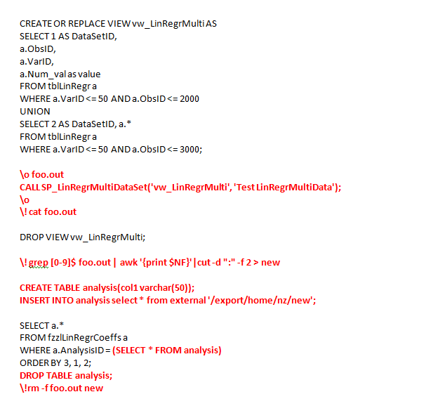
Error handled

Slide 10
Plans Ahead
Testing
Individual .tst files for each separate function to be created.
Each file containing positive and negative tests for the function.
Finding cases where these functions could break
Running all these functions on pulsar to check the validity of .tst files
Process to be done for about 350 functions in the library.

Slide 11

Thank You!

